Slide 1
Chapter 9: 8086/8088 Hardware Specifications

Slide 2
Introduction
In this chapter, the pin functions of both the 8086 and 8088 microprocessors are detailed and information is provided on the following hardware topics: clock generation, bus buffering, bus latching, timing, wait states, and minimum mode operation versus maximum mode operation.
These simple microprocessors are explained as an introduction to the Intel microprocessor family.

Slide 3
9–1 PIN-OUTS AND THE PIN FUNCTIONS
In this section, we explain the function and
the multiple functions of each of the microprocessor’s pins.
In addition, we discuss the DC characteristics to provide a basis for understanding the later sections on buffering and latching.

Slide 4
The Pin-Out
Figure 9–1 illustrates pin-outs of 8086 & 8088.
  both are packaged in 40-pin dual in-line packages (DIPs)
8086 is a 16-bit microprocessor with a 16-bit data bus; 8088 has an 8-bit data bus.
  8086 has pin connections AD₀–AD₁₅
  8088 has pin connections AD₀–AD₇
Data bus width is the only major difference.
  thus 8086 transfers 16-bit data more efficiently

Slide 5
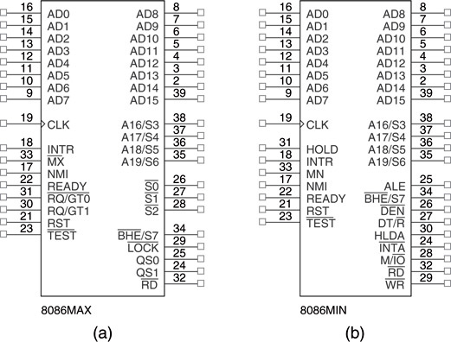
Figure 9–1 (a) The pin-out of the 8086 in maximum mode; (b) the pin-out of the 8086 in minimum mode.

Slide 6
Power Supply Requirements
Both microprocessors require +5.0 V with a supply voltage tolerance of ±10 percent.
  8086 uses a maximum supply current of 360 mA
  8088 draws a maximum of 340 mA
Both microprocessors operate in ambient temperatures of between 32° F and 180° F.
80C88 and 80C86 are CMOS versions that require only 10 mA of power supply current.
  and function in temperature extremes of –40° F through +225° F

Slide 7
DC Characteristics
It is impossible to connect anything to a
microprocessor without knowing input current requirement for an input pin.
  and the output current drive capability for an output pin
This knowledge allows hardware designers
to select proper interface components for use with the microprocessor
  without the fear of damaging anything

Slide 8
Input Characteristics
Input characteristics of these microprocessors are compatible with all the standard logic components available today.
Table 9–1 depicts input voltage levels and
the input current requirements for any input pin on either microprocessor.
The input current levels are very small because the inputs are the gate connections of MOSFETs and represent only leakage currents.

Slide 9
Output Characteristics
Table 9–2 illustrates output characteristics of all the output pins of these microprocessors.
The logic 1 voltage level of the 8086/8088 is compatible with most standard logic families.
  logic 0 level is not
Standard logic circuits have a maximum logic 0 voltage of 0.4 V; 8086/8088 has a maximum of 0.45 V.
  a difference of 0.05 V

Slide 10
This difference reduces the noise immunity from 400 mV (0.8 V – 0.45 V) to 350 mV.
  noise immunity is the difference between logic 0 output voltage and logic 0 input voltage levels
Reduction in noise immunity may result in problems with long wire connections or too many loads.
No more than 10 loads of any type should be connected to an output pin without buffering
  if this factor is exceeded, noise will begin to take its toll in timing problems

Slide 11
Pin Connections AD₇ - AD₀
8088 address/data bus lines are multiplexed
  and contain the rightmost 8 bits of the memory address or I/O port number whenever ALE is active (logic 1)
  or data whenever ALE is inactive (logic 0)
These pins are at their high-impedance state during a hold acknowledge.

Slide 12
Pin Connections A₁₅ - A₈
8088 address bus provides the upper-half memory address bits that are present throughout a bus cycle.
These address connections go to their high-impedance state during a hold acknowledge.

Slide 13
Pin Connections AD₁₅ - AD₈
8086 address/data bus lines compose upper multiplexed address/data bus on the 8086.
These lines contain address bits A₁₅–A₈ whenever ALE is a logic 1, and data bus connections D₁₅–D₈ when ALE is a logic 0.
These pins enter a high-impedance state when a hold acknowledge occurs.

Slide 14
Pin Connections A₁₉/S₆ - A₁₆/S₃
Address/status bus bits are multiplexed to provide address signals A₁₉–A₁₆ and status bits S₆–S₃.
  high-impedance state during hold acknowledge
  status bit S₆ is always logic 0,
  bit S₅ indicates the condition of the IF flag bit
S₄ and S₃ show which segment is accessed during the current bus cycle.
  these status bits can address four separate 1M byte memory banks by decoding as A₂₁ and A₂₀

Slide 15
Pin Connections RD
When read signal is logic 0, the data bus is receptive to data from memory or I/O devices
  pin floats high-impedance state during a hold acknowledge
Ready
Inserts wait states into the timing.
  if placed at a logic 0, the microprocessor enters into wait states and remains idle
  if logic 1, no effect on the operation

Slide 16
Pin Connections INTR
Interrupt request is used to request a hardware interrupt.
  If INTR is held high when IF = 1, 8086/8088
  enters an interrupt acknowledge cycle after the current instruction has completed execution
NMI
The non-maskable interrupt input is similar to INTR.
  does not check IF flag bit for logic 1
  if activated, uses interrupt vector 2

Slide 17
Pin Connections TEST
The Test pin is an input that is tested by the WAIT instruction.
If TEST is a logic 0, the WAIT instruction functions as an NOP.
If TEST is a logic 1, the WAIT instruction
waits for TEST to become a logic 0.
The TEST pin is most often connected to
the 8087 numeric coprocessor.

Slide 18
Pin Connections RESET
Causes the microprocessor to reset itself if held high a minimum of four clocking periods.
  when 8086/8088 is reset, it executes instructions at memory location FFFFOH
  also disables future interrupts by clearing IF flag
CLK
The clock pin provides the basic timing signal.
  must have a duty cycle of 33 % (high for one third of clocking period, low for two thirds) to provide proper internal timing

Slide 19
Pin Connections VCC
This power supply input provides a +5.0 V, ±10 % signal to the microprocessor.
GND
The ground connection is the return for the power supply.
  8086/8088 microprocessors have two pins
  labeled GND—both must be connected to
  ground for proper operation

Slide 20
Pin Connections MN/MX
Minimum/maximum mode pin selects either minimum or maximum mode operation.
  if minimum mode selected, the MN/MX pin must
  be connected directly to +5.0 V
BHE/S₇
The bus high enable pin is used in 8086 to enable the most-significant data bus bits
(D₁₅–D₈) during a read or a write operation.
The state of S₇ is always a logic 1.

Slide 21
Minimum Mode Pins
Minimum mode operation is obtained by connecting the MN/MX pin directly to +5.0 V.
  do not connect to +5.0 V through a pull-up register; it will not function correctly
IO/M or M/IO
The IO/M (8088) or M/IO (8086) pin selects memory or I/O.
  indicates the address bus contains either a memory address or an I/O port address.
  high-impedance state during hold acknowledge

Slide 22
Minimum Mode Pins WR
Write line indicates 8086/8088 is outputting data to a memory or I/O device.
  during the time WR is a logic 0, the data bus contains valid data for memory or I/O
  high-impedance during a hold acknowledge
INTA
The interrupt acknowledge signal is a response to the INTR input pin.
  normally used to gate the interrupt vector number onto the data bus in response to an interrupt

Slide 23
Minimum Mode Pins ALE
Address latch enable shows the 8086/8088 address/data bus contains an address.
  can be a memory address or an I/O port number
  ALE signal doesn’t float during hold acknowledge
DT/R
The data transmit/receive signal shows that the microprocessor data bus is transmitting (DT/R = 1) or receiving (DT/R = 0) data.
  used to enable external data bus buffers

Slide 24
Minimum Mode Pins DEN
Data bus enable activates external data bus buffers.
HOLD
Hold input requests a direct memory access (DMA).
  if HOLD signal is a logic 1, the microprocessor stops executing software and places address, data, and control bus at high-impedance
  if a logic 0, software executes normally

Slide 25
Minimum Mode Pins HLDA
Hold acknowledge indicates the 8086/8088 has entered the hold state.
SS0
The SS0 status line is equivalent to the S₀
pin in maximum mode operation.
Signal is combined with IO/M and DT/R to decode the function of the current bus cycle.

Slide 26
Maximum Mode Pins
In order to achieve maximum mode for use with external coprocessors, connect the MN/MX pin to ground.
S2, S1, and S0
Status bits indicate function of the current
bus cycle.
  normally decoded by the 8288 bus controller

Slide 27
Maximum Mode Pins RQ/GT1
The request/grant pins request direct memory accesses (DMA) during maximum mode operation.
  bidirectional; used to request and grant a DMA operation
LOCK
The lock output is used to lock peripherals off the system. This pin is activated by using the LOCK: prefix on any instruction.

Slide 28
Maximum Mode Pins QS₁ and QS₀
The queue status bits show the status of the internal instruction queue.
  provided for access by the 8087 coprocessor

Slide 29
9–2 CLOCK GENERATOR (8284A)
This section describes the 8484A clock generator and the RESET signal.
  also introduces the READY signal for 8086/8088
With no clock generator, many circuits would be required to generate the clock (CLK).
8284A provides the following basic functions:
  clock generation; RESET & READY synch;
  TTL-level peripheral clock signal
Figure 9–2 shows pin-outs of the 8284A

Slide 30
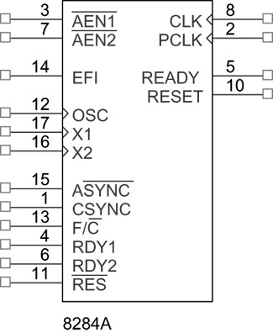
Figure 9–2 The pin-out of the 8284A clock generator.

Slide 31
8284A Pin Functions
8284A is an 18-pin integrated circuit designed specifically for use 8086/8088.
AEN1 and AEN2
The address enable pins are provided to qualify bus ready signals, RDY1 and RDY2.
  used to cause wait states
Wait states are generated by the READY pin of 8086/8088 controlled by these two inputs.

Slide 32
Pin Functions RDY₁ and RDY₂
The bus ready inputs are provided, in conjunction with the AEN1 & AEN2 pins,
to cause wait states in 8086/8088.
ASYNC
The ready synchronization selection input selects either one or two stages of synchronization for the RDY₁ and RDY₂ inputs.

Slide 33
Pin Functions READY
Ready is an output pin that connects to the 8086/8088 READY input.
  synchronized with the RDY₁ and RDY₂ inputs
X₁ and X₂
The crystal oscillator pins connect to an external crystal used as the timing source
for the clock generator and all its functions

Slide 34
Pin Functions F/C
The frequency/crystal select input chooses the clocking source for the 8284A.
  if held high, an external clock is provided to the EFI input pin
  if held low, the internal crystal oscillator provides the timing signal
The external frequency input is used when the F/C pin is pulled high.
EFI supplies timing when the F/C pin is high.

Slide 35
Pin Functions CLK
The clock output pin provides the CLK input signal to 8086/8088 and other components.
  output signal is one third of the crystal or EFI
  input frequency
  33% duty cycle required by the 8086/8088
PCLK
The peripheral clock signal is one sixth the crystal or EFI input frequency.
  PCLK output provides a clock signal to the peripheral equipment in the system

Slide 36
Pin Functions OSC
Oscillator output is a TTL-level signal at the same frequency as crystal or EFI input.
  OSC output provides EFI input to other 8284A clock generators in multiple-processor systems
RES
Reset input is an active-low input to 8284A.
  often connected to an RC network that provides power-on resetting

Slide 37
Pin Functions RESET
Reset output is connected to the 8086/8088 RESET input pin.
CSYNCH
The clock synchronization pin is used when the EFI input provides synchronization in systems with multiple processors.
  if internal crystal oscillator is used, this pin must be grounded

Slide 38
Pin Functions GND
The ground pin connects to ground.
VCC
This power supply pin connects to +5.0 V with a tolerance of ±10%.

Slide 39
Operation of the 8284A
The 8284A is a relatively easy component
to understand.
Figure 9–3 illustrates the internal block diagram of the 8284A clock generator.
The top half of the logic diagram represents the clock and synchronization section of the 8284A clock generator.

Slide 40
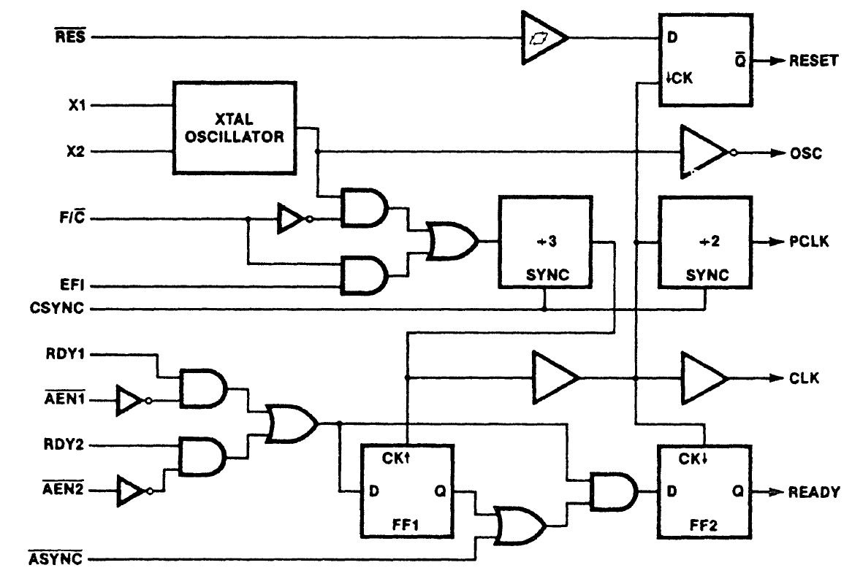
Figure 9–3 The internal block diagram of the 8284A clock generator.

Slide 41
Operation of the Clock Section
Crystal oscillator has two inputs: X₁ and X₂.
  if a crystal is attached to X₁ and X₂, the oscillator generates a square-wave signal at the same frequency as the crystal
The square-wave is fed to an AND gate & an inverting buffer to provide an OSC output.
The OSC signal is sometimes used as an EFI input to other 8284A circuits in a system.
Figure 9–4 shows how an 8284A is connected to the 8086/8088.

Slide 42
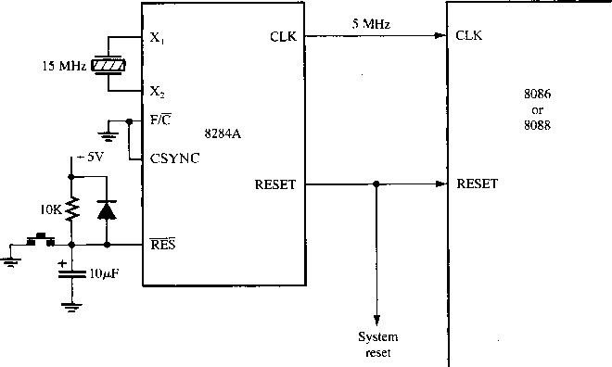
Figure 9–4 The clock generator (8284A) and the 8086 and 8088 microprocessors illustrating the connection for the clock and reset signals. A 15 MHz crystal provides the 5 MHz clock for the microprocessor.

Slide 43
Operation of the Reset Section
The reset section of 8284A consists of a Schmitt trigger buffer and a D-type flip-flop.
  the D-type flip-flop ensures timing requirements
  of 8086/8088 RESET input are met
This circuit applies the RESET signal on the negative edge (1-to-0 transition) of each clock.
8086/8088 microprocessors sample RESET at the positive edge (0-to-1 transition) clocks.
  thus, this circuit meets 8086/8088 timing requirements

Slide 44
9–3 BUS BUFFERING AND LATCHING
Before 8086/8088 can be used with memory
or I/O interfaces, their multiplexed buses must be demultiplexed.
This section provides detail required to demultiplex the buses and illustrates how
the buses are buffered for very large systems.
  because the maximum fan-out is 10, the system must be buffered if it contains more than 10 other components

Slide 45
Demultiplexing the Buses
The address/data bus of the 8086/8088 is multiplexed (shared) to reduce the number
of pins required for the integrated circuit
  the hardware designer must extract or
  demultiplex information from these pins
Memory & I/O require the address remain valid and stable throughout a read/write cycle.
If buses are multiplexed, the address changes at the memory and I/O, causing them to read or write data in the wrong locations

Slide 46
All computer systems have three buses:
  an address bus that provides memory and I/O with the memory address or the I/O port number
  a data bus that transfers data between the microprocessor and the memory and I/O
  a control bus that provides control signals to
  the memory and I/O
These buses must be present in order to interface to memory and I/O.

Slide 47
Demultiplexing the 8088
Figure 9–5 illustrates components required to demultiplex 8088 buses.
  two 74LS373 or 74LS573 transparent latches are used to demultiplex the address/data bus connections AD₇–AD₀
  and address/status connections A₁₉/S₆–A₁₆/S₃
The latches, which are like wires whenever the address latch enable pin (ALE) becomes a logic 1, pass the inputs to the outputs.

Slide 48
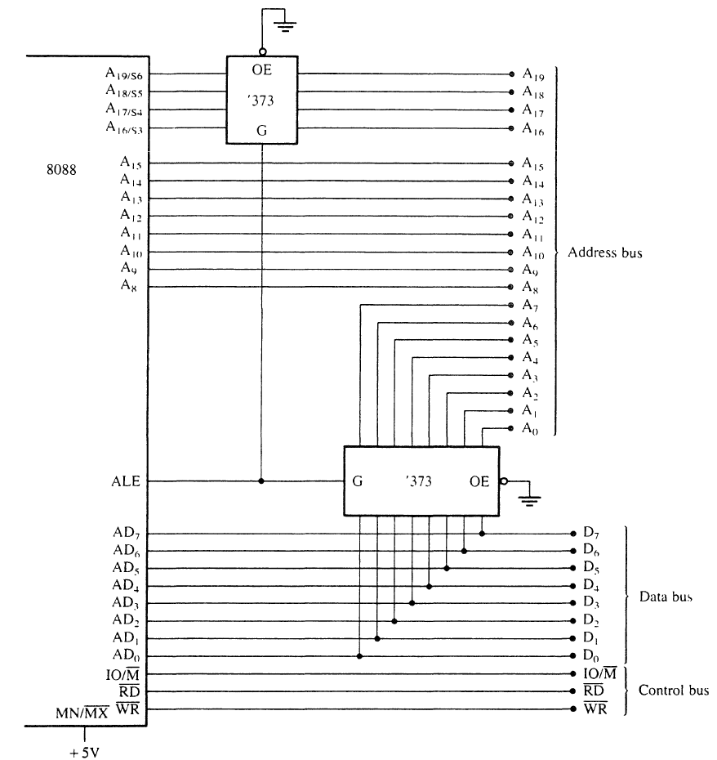
Figure 9–5 The 8088 microprocessor shown with a demultiplexed address bus. This is the model used to build many 8088-based systems.

Slide 49
After a short time, ALE returns to logic 0 causing the latches to remember inputs at
the time of the change to a logic 0.
This yields a separate address bus with connections A₁₉–A₀.
  these allow 8088 to address 1Mb of memory
The separate data bus allows it to be connected to any 8-bit peripheral device or memory component.

Slide 50
Demultiplexing the 8086
Fig 9–6 illustrates a demultiplexed 8086 with all three buses:
address (A₁₉–A₀ and BHE )
data (D₁₅–D₀),
control (M/IO,RD, and WR )
Here, the memory and I/O system see the 8086 as a device with:
  a 20-bit address bus;16-bit data bus
  and a three-line control bus

Slide 51
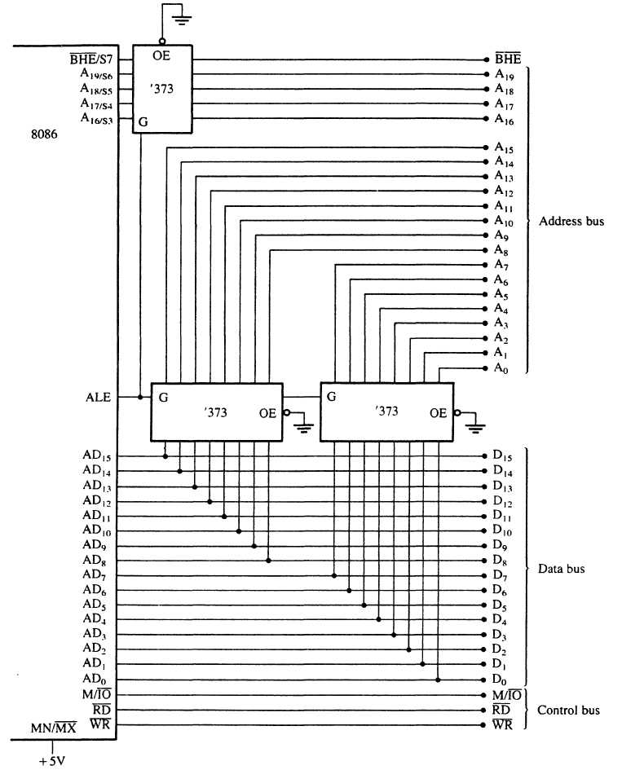
Figure 9–6 The 8086 microprocessor shown with a demultiplexed address bus. This is the model used to build many 8086-based systems.

Slide 52
The Buffered System
If more than 10 unit loads are attached to any bus pin, the entire system must be buffered.
Buffer output currents have been increased
so that more TTL unit loads may be driven.
A fully buffered signal will introduce a timing delay to the system.
No difficulty unless memory or I/O devices
are used which function at near maximum
bus speed.

Slide 53
The Fully Buffered 8088
Figure 9–7 depicts a fully buffered 8088 microprocessor.
  a fully buffered 8088 system requires two 74LS244s, one 74LS245, and two 74LS373s
Direction of the 74LS245 is controlled by the DT/R signal.
  enabled and disabled by the DEN signal

Slide 54
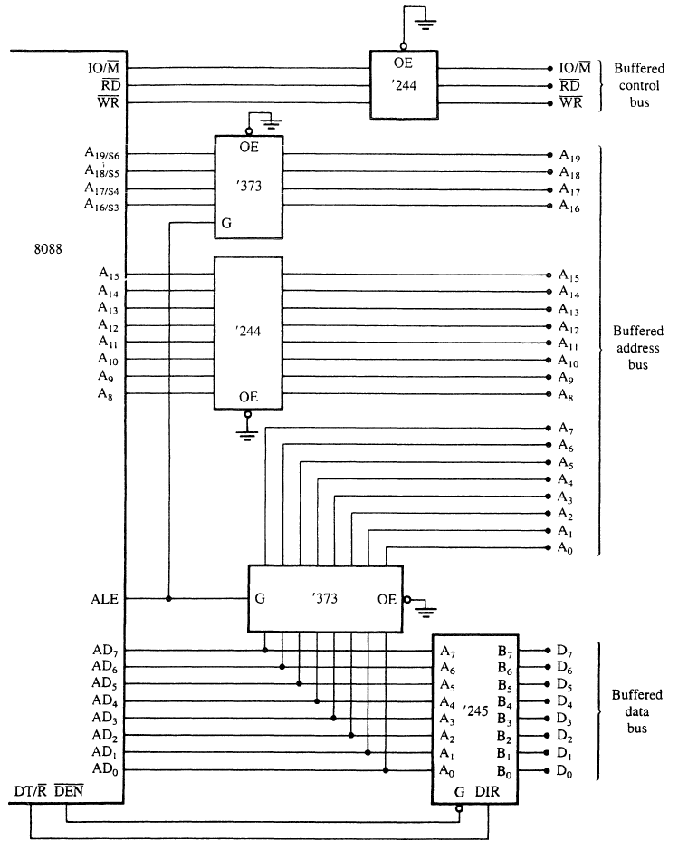
Figure 9–7 A fully buffered 8088 microprocessor.

Slide 55
The Fully Buffered 8086
Figure 9–8 illustrates a fully buffered 8086.
  a fully buffered 8086 system requires one 74LS244, two 74LS245s, and three 74LS373s
8086 requires one more buffer than 8088 because of the extra eight data bus connections, D₁₅–D₈.
It also has a BHE signal that is buffered for memory-bank selection.

Slide 56
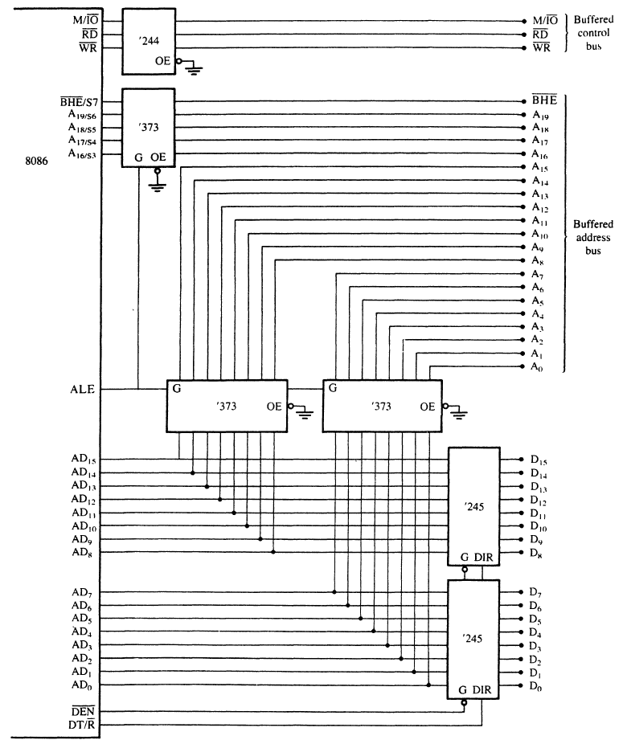
Figure 9–8 A fully buffered 8086 microprocessor.

Slide 57
9–4 BUS TIMING
It is essential to understand system bus timing before choosing memory or I/O devices for interfacing to 8086 or 8088 microprocessors.
This section provides insight into operation
of the bus signals and the basic read/write timing of the 8086/8088.

Slide 58
Basic Bus Operation
The three buses of 8086/8088 function the same way as any other microprocessor.
If data are written to memory the processor:
  outputs the memory address on the address bus
  outputs the data to be written on the data bus
  issues a write (WR) to memory
  and IO/M= 0 for 8088 and IO/M = 1 for 8086
See simplified timing for write in Fig 9–9.

Slide 59
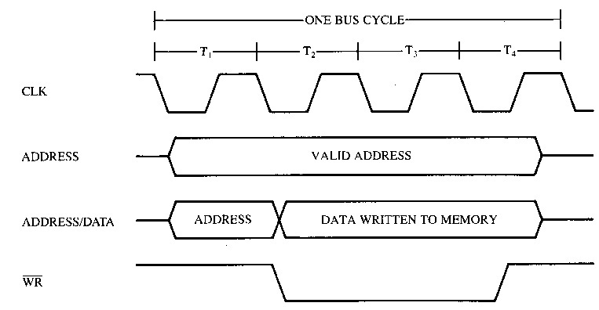
Figure 9–9 Simplified 8086/8088 write bus cycle.

Slide 60
If data are read from the memory the microprocessor:
  outputs the memory address on the address bus
  issues a read memory signal (RD)
  and accepts the data via the data bus
See simplified timing for read in Fig 9–10.

Slide 61
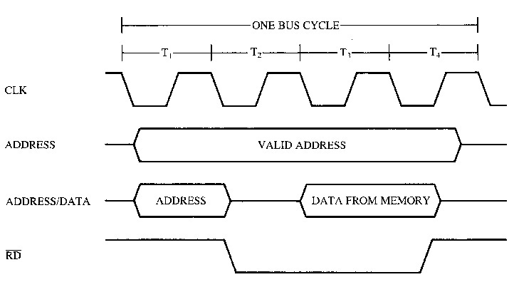
Figure 9–10 Simplified 8086/8088 read bus cycle.

Slide 62
Timing in General
8086/8088 use memory and I/O in periods called bus cycles.
Each cycle equals four system-clocking periods (T states).
  newer microprocessors divide the bus cycle
  into as few as two clocking periods
If the clock is operated at 5 MHz, one 8086/8088 bus cycle is complete in 800 ns.
  basic operating frequency for these processors

Slide 63
During the first clocking period in a bus cycle, called T1, many things happen:
  the address of the memory or I/O location is sent out via the address bus and the address/data bus connections.
During TI, control signals are also output.
  indicating whether the address bus contains a memory address or an I/O device (port) number
During T2, the processors issue the RD or WR signal, DEN, and in the case of a write, the data to be written appear on the data bus.

Slide 64
These events cause the memory or I/O device to begin to perform a read or a write.
READY is sampled at the end of T₂.
  if low at this time, T₃ becomes a wait state (T_{w})
  this clocking period is provided to allow the memory time to access data
If a read bus cycle, the data bus is sampled at the end of T₃.
Illustrated in Figure 9–11.

Slide 65
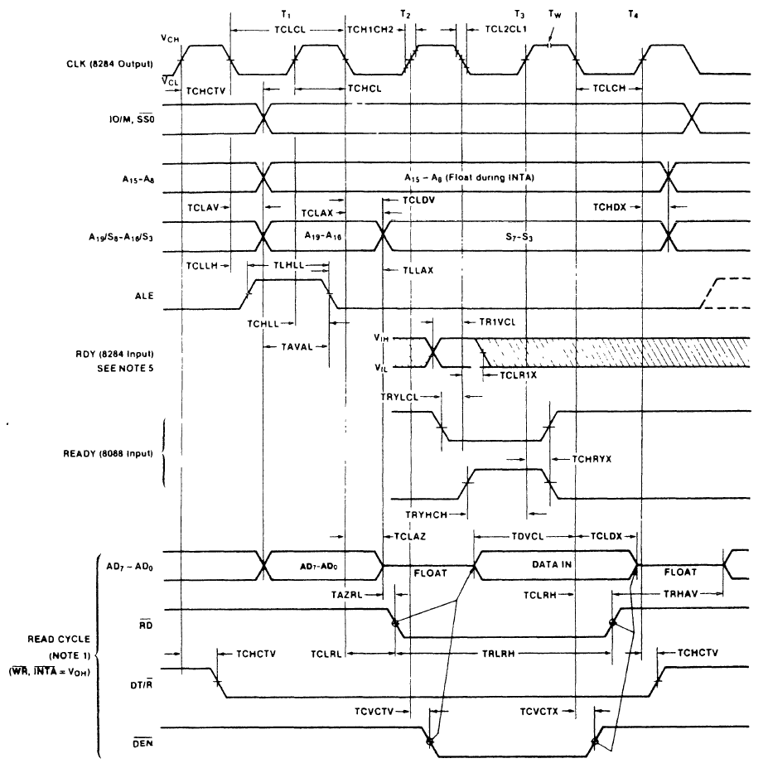
Figure 9–11 Minimum mode 8088 bus timing for a read operation.
  In T₄, all bus signals
  are deactivated in preparation for the
  next bus cycle
  data bus connections are sampled for data
  read from memory or I/O

Slide 66
Read Timing
Figure 9–11 also depicts 8088 read timing.
  8086 has 16 rather than eight data bus bits
Important item in the read timing diagram is time allowed for memory & I/O to read data.
Memory is chosen by its access time.
  the fixed amount of time the microprocessor allows it to access data for the read operation
It is extremely important that memory chosen complies with the limitations of the system.

Slide 67
The microprocessor timing diagram does not provide a listing for memory access time.
  necessary to combine several times to arrive at the access time
Memory access time starts when the address appears on the memory address bus and continues until the microprocessor samples the memory data at T₃.
  about three T states elapse between these times
The address does not appear until T_{CLAV} time (110 ns if a 5 Mhz clock) after the start of T₁.

Slide 68
T_{CLAV} time must be subtracted from the three clocking states (600 ns) separating the appearance of the address (T₁) and the sampling of the data (T₃).
The data setup time (T_{DVCL}), which occurs before T₃ must also be subtracted.
Memory access time is thus three clocking states minus the sum of T_{CLAV} and T_{DVCL}.
Because T_{DVCL} is 30 ns with a 5 MHz clock, the allowed memory access time is only 460 ns (access time = 600 ns –110 ns – 30 ns).

Slide 69
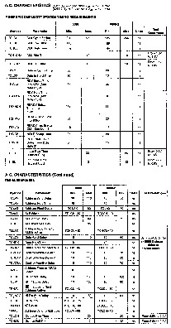
Figure 9–12 8088 AC characteristics.
To find memory access time
in this diagram:
  locate the point in T₃ when data are sampled
  you will notice a line that extends from the end
  of T₃ down to the data bus
  at the end of T₃, the microprocessor samples
  the data bus.

Slide 70
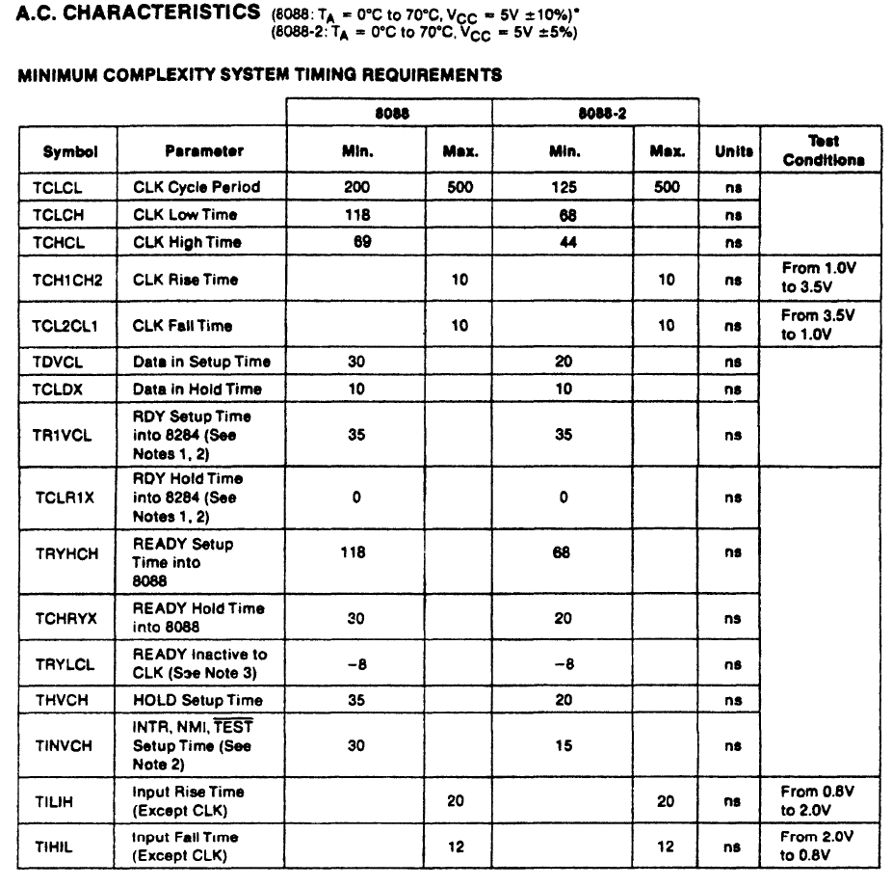

Slide 71
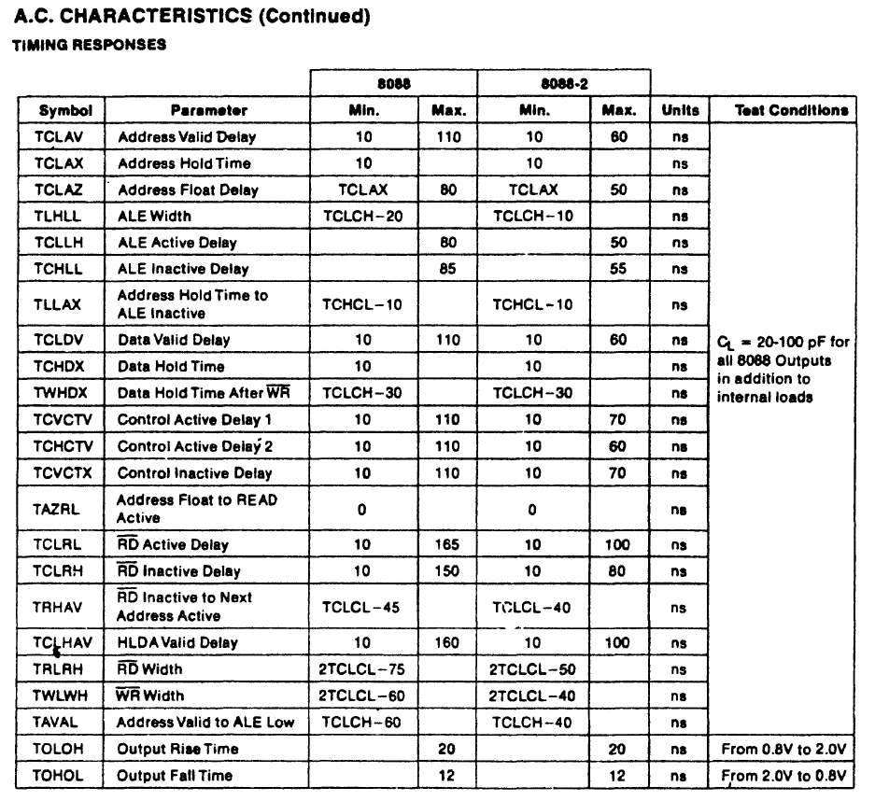

Slide 72
Memory devices chosen for connection to the 8086/8088 operating at 5 MHz must be able to access data in less than 460 ns.
  because of the time delay introduced by the address decoders and buffers in the system
  a 30- or 40-ns margin should exist for the operation of these circuits
The memory speed should be no slower than about 420 ns to operate correctly with the 8086/8088 microprocessors.

Slide 73
Strobe Width
The other timing factor to affect memory operation is the width of the RD strobe.
On the timing diagram, the read strobe is given as T_{RLRH}.
The time for this strobe at a 5 MHz clock rate is 325 ns.
This is wide enough for almost all memory devices manufactured with an access time
of 400 ns or less.

Slide 74
Write Timing
Figure 9–13 illustrates 8088 write-timing.
  8086 is nearly identical
The RD strobe is replaced by the WR strobe,
  the data bus contains information for the memory rather than information from the memory,
  DT/R remains a logic 1 instead of a logic 0 throughout the bus cycle
When interfacing some devices, timing may be critical between when WR becomes logic 1 and the data are removed from the data bus.

Slide 75
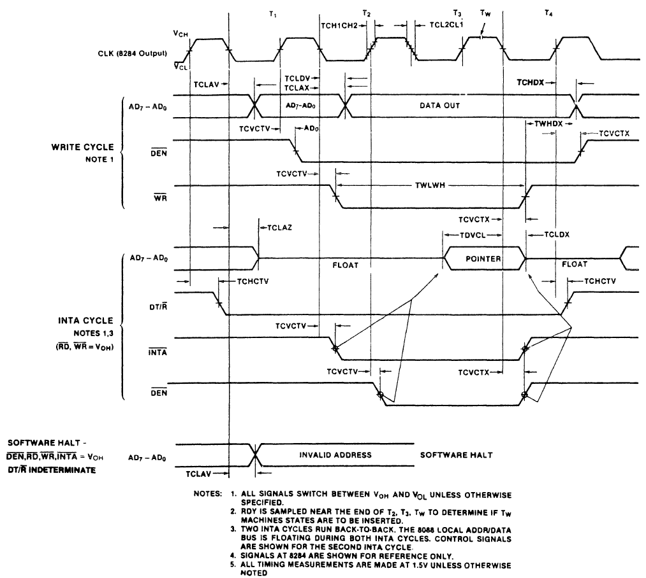
Figure 9–13 Minimum mode 8088 write bus timing.

Slide 76
Memory data are written at the trailing edge
of the WR strobe.
On the diagram, this critical period is T_{WHDX}
or 88 ns when 8088 on a 5 MHz clock.
Hold time is often less than this.
  in fact often 0 ns for memory devices
The width of the WR strobe is T_{WLWH} or
340 ns with a 5 MHz clock.
This rate is compatible with most memory devices with access time of 400 ns or less.

Slide 77
9–5 READY AND THE WAIT STATE
The READY input causes wait states for slower memory and I/O components.
  a wait state (T_{w}) is an extra clocking period between T₂ and T₃ to lengthen bus cycle
  on one wait state, memory access time of 460 ns, is lengthened by one clocking period (200 ns) to 660 ns, based on a 5 MHz clock
This section covers READY synchronization circuitry inside the 8284A clock generator.

Slide 78
The READY Input
The READY input is sampled at the end of T₂ and again, if applicable, in the middle of T_{w}.
The READY input to 8086/8088 has stringent timing requirements.
Fig 9–14 shows READY causing one wait state (T_{w}), with the required setup and hold times from the system clock.
When the 8284A is used for READY, the
RDY (ready input to 8284A) input occurs at the end of each T state.

Slide 79
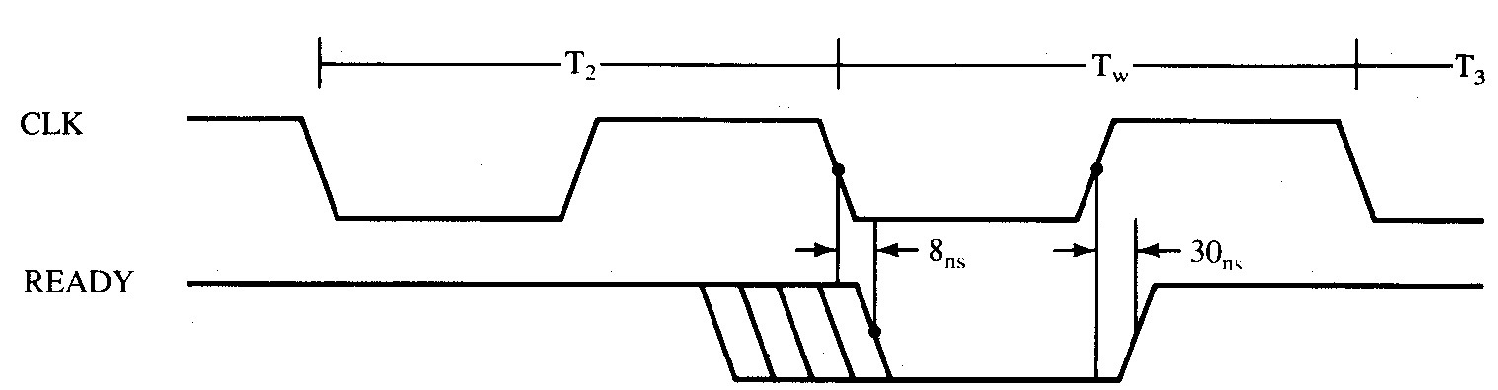
Figure 9–14 8086/8088 READY input timing.
If READY is logic 0 at the end of T₂, T₃ is delayed and T_{w} inserted between T₂ and T₃.
READY is next sampled at the middle of T_{w}
to determine if the next state is T_{w} or T₃.

Slide 80
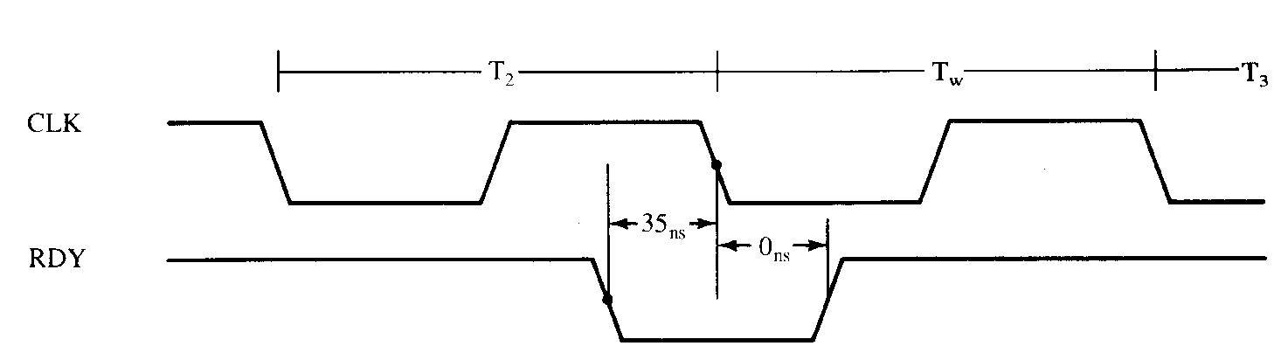
RDY and the 8284A
RDY is the synchronized ready input to the 8284A clock generator.
Internal 8284A circuitry guarantees the accuracy of the READY synchronization.
Figure 9–15 8284A RDY input timing.

Slide 81
Fig 9–16 depicts internal structure of 8284A.
  the bottom half is the READY synch circuitry
Fig 9–17 shows a circuit to introduce almost any number of wait states to 8086/8088.
An 8-bit serial shift register (74LS164) shifts a logic 0 for one or more clock periods from one of its Q outputs through to the RDY1 input of the 8284A.
With appropriate strapping, this circuit can provide various numbers of wait states.

Slide 82
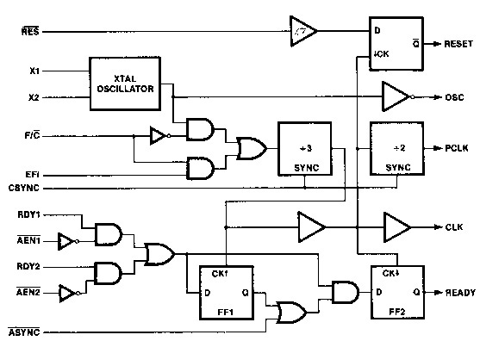
Figure 9–16 The internal block diagram of the 8284A clock generator. (Courtesy of Intel Corporation.)

Slide 83
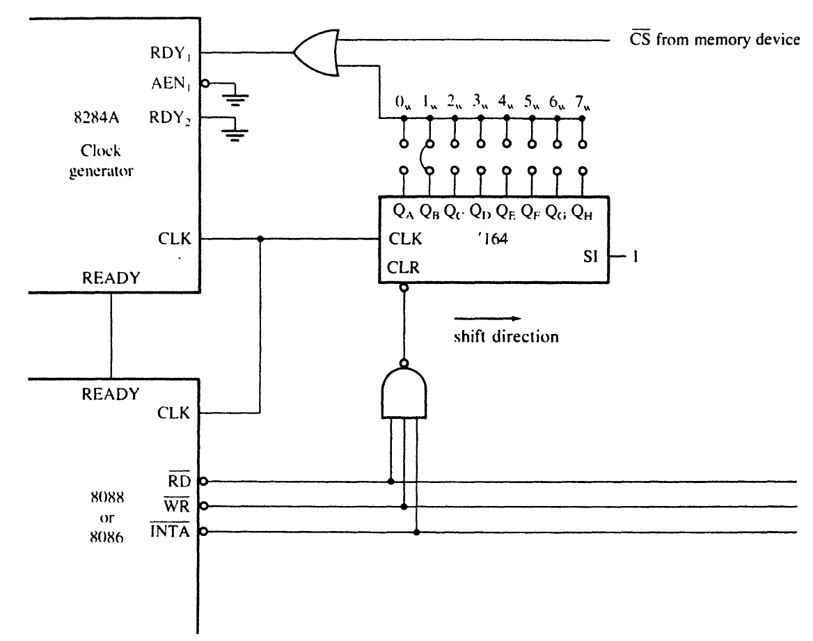
Figure 9–17 A circuit that will cause between 0 and 7 wait states.

Slide 84
Note in Fig 9–17 that this circuit is enabled only for devices that need insertion of waits.
  if the selection signal is a logic 0, the device is selected and this circuit generates a wait state
Figure 9–18 shows timing of this shift register wait state generator when wired to insert one wait state.
The timing diagram also illustrates the internal contents of the shift register’s flip-flops
  to present a more detailed view of its operation
In this example, one wait state is generated.

Slide 85
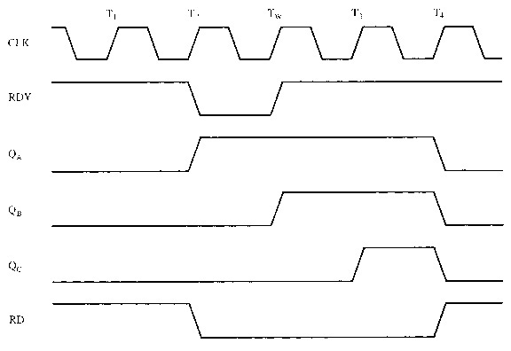
Figure 9–18 Wait state generation timing of the circuit of Figure 9–17.

Slide 86
9–6 MINIMUM VS MAXIMUM MODE
Minimum mode is obtained by connecting the mode selection MN/MX pin to +5.0 V,
  maximum mode selected by grounding the pin
The mode of operation provided by minimum mode is similar to that of the 8085A
  the most recent Intel 8-bit microprocessor
Maximum mode is designed to be used whenever a coprocessor exists in a system.
  maximum mode was dropped with 80286

Slide 87
Minimum Mode Operation
Least expensive way to operate 8086/8088.
  because all control signals for the memory & I/O are generated by the microprocessor
Control signals are identical to Intel 8085A.
The minimum mode allows 8085A 8-bit peripherals to be used with the 8086/8088 without any special considerations.

Slide 88
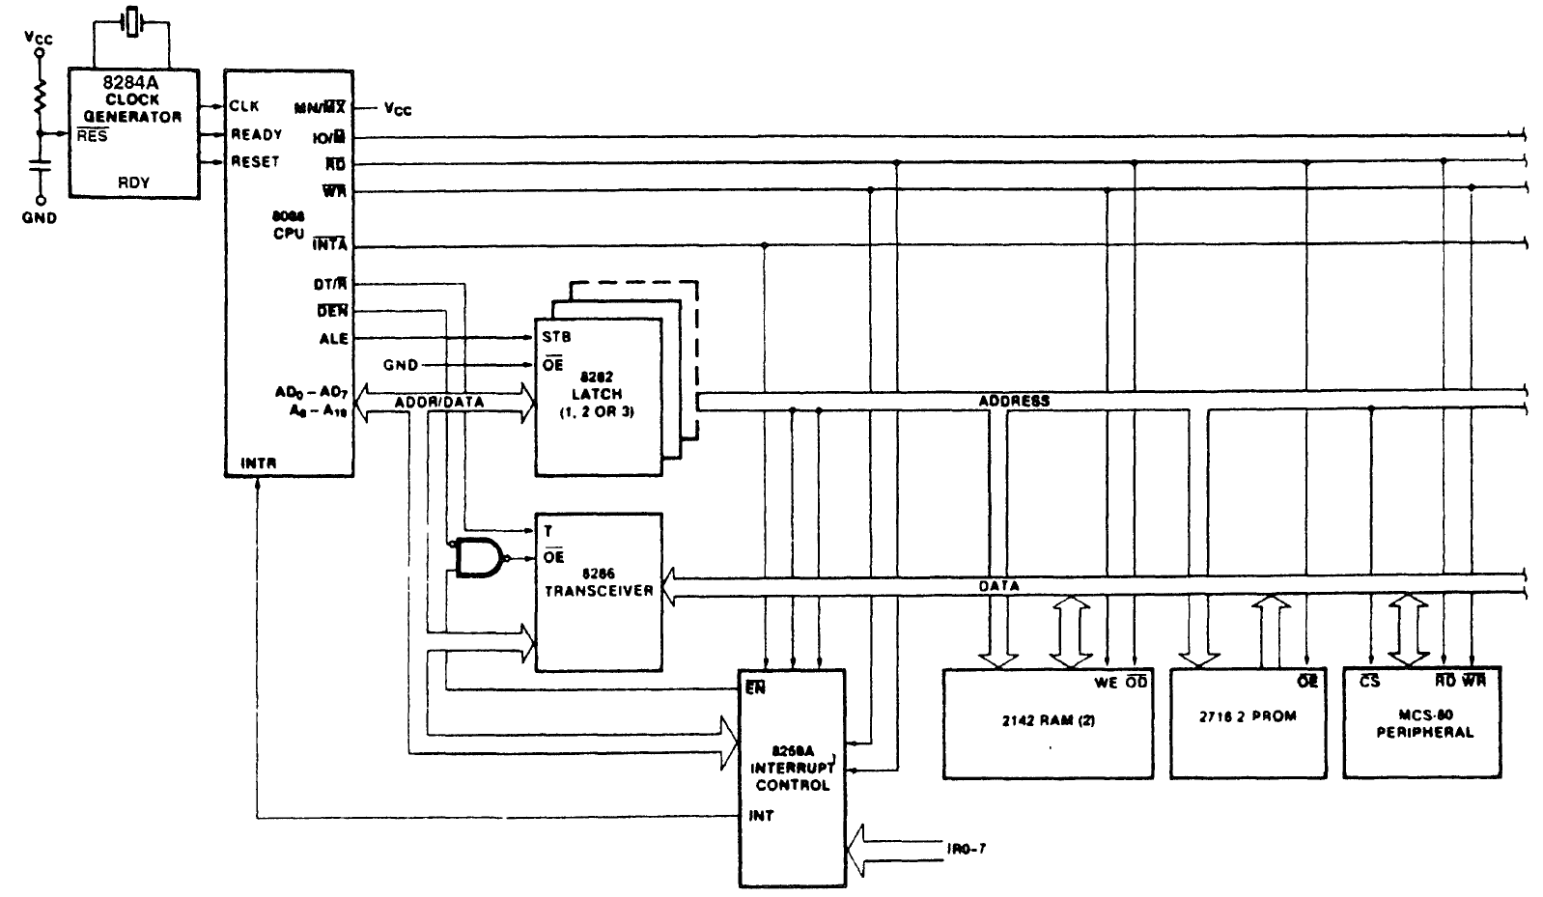
Figure 9–19 Minimum mode 8088 system.

Slide 89
Maximum Mode Operation
Differs from minimum mode in that some control signals must be externally generated.
  requires addition of the 8288 bus controller
There are not enough pins on the 8086/8088 for bus control during maximum mode
  new pins and features replaced some of them
Maximum mode used only when the system contains external coprocessors such as 8087.

Slide 90
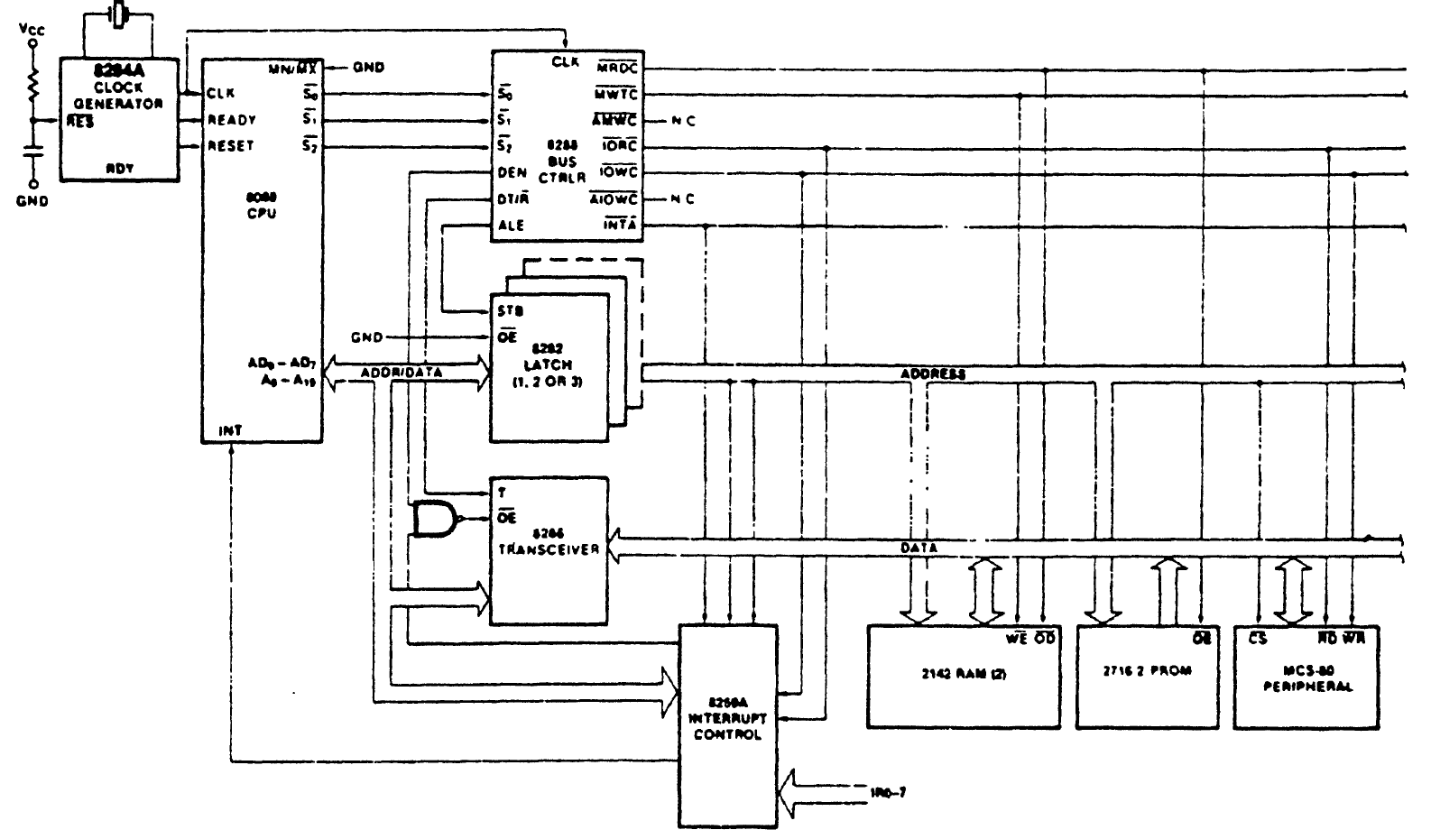
Figure 9–20 Maximum mode 8088 system.

Slide 91
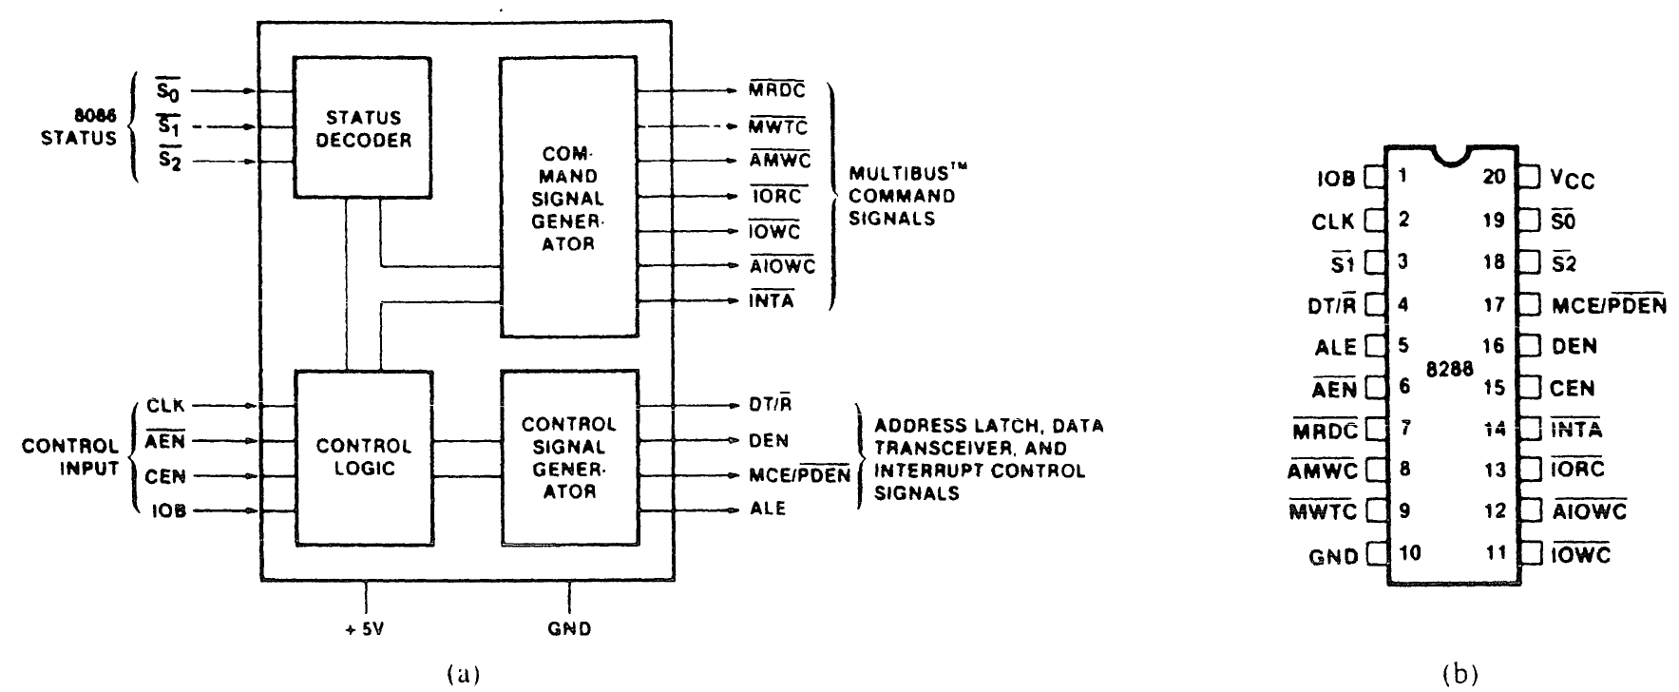
The 8288 Bus Controller
Provides the signals eliminated from the 8086/8088 by the maximum mode operation.
Figure 9–21 The 8288 bus controller; (a) block diagram and (b) pin-out.

Slide 92
8288 Pin Functions
S₂, S₁, and S₀
Status inputs are connected to the status output pins on 8086/8088.
  three signals decoded to generate timing signals
CLK
The clock input provides internal timing.
  must be connected to the CLK output pin of
  the 8284A clock generator

Slide 93
8288 Pin Functions
ALE
The address latch enable output is used to demultiplex the address/data bus.
DEN
The data bus enable pin controls the bidirectional data bus buffers in the system.
DT/R
Data transmit/receive signal output to control direction of the bidirectional data bus buffers.

Slide 94
8288 Pin Functions
AEN
The address enable input causes the 8288 to enable the memory control signals.
CEN
The control enable input enables the command output pins on the 8288.
IOB
The I/O bus mode input selects either I/O
bus mode or system bus mode operation.

Slide 95
8288 Pin Functions
AIOWC
Advanced I/O write is a command output to an advanced I/O write control signal.
IORC
The I/O read command output provides
I/O with its read control signal.
IOWC
The I/O write command output provides I/O with its main write signal.

Slide 96
8288 Pin Functions
AMWT
Advanced memory write control pin provides memory with an early/advanced write signal.
MWTC
The memory write control pin provides memory with its normal write control signal.
MRDC
The memory read control pin provides memory with a read control signal.

Slide 97
8288 Pin Functions
INTA
The interrupt acknowledge output acknowledges an interrupt request input applied to the INTR pin.
MCE/PDEN
The master cascade/peripheral data output selects cascade operation for an interrupt controller if IOB is grounded, and enables the I/O bus transceivers if IOB is tied high.

